Slide 1
MIST 7600 Data Management and Analytics
Dr. Ling Xue

Slide 2
Managing Data

Slide 3
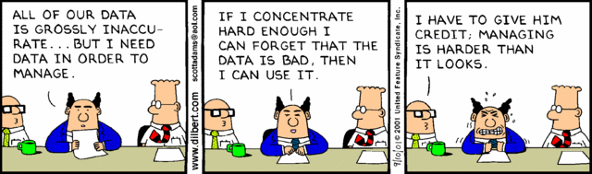
Managing Data
“The Cost of bad or ‘dirty’ data exceeds $600 Billion dollars for US businesses annually.”
-Data Warehousing Institute (TDWI)

Slide 4
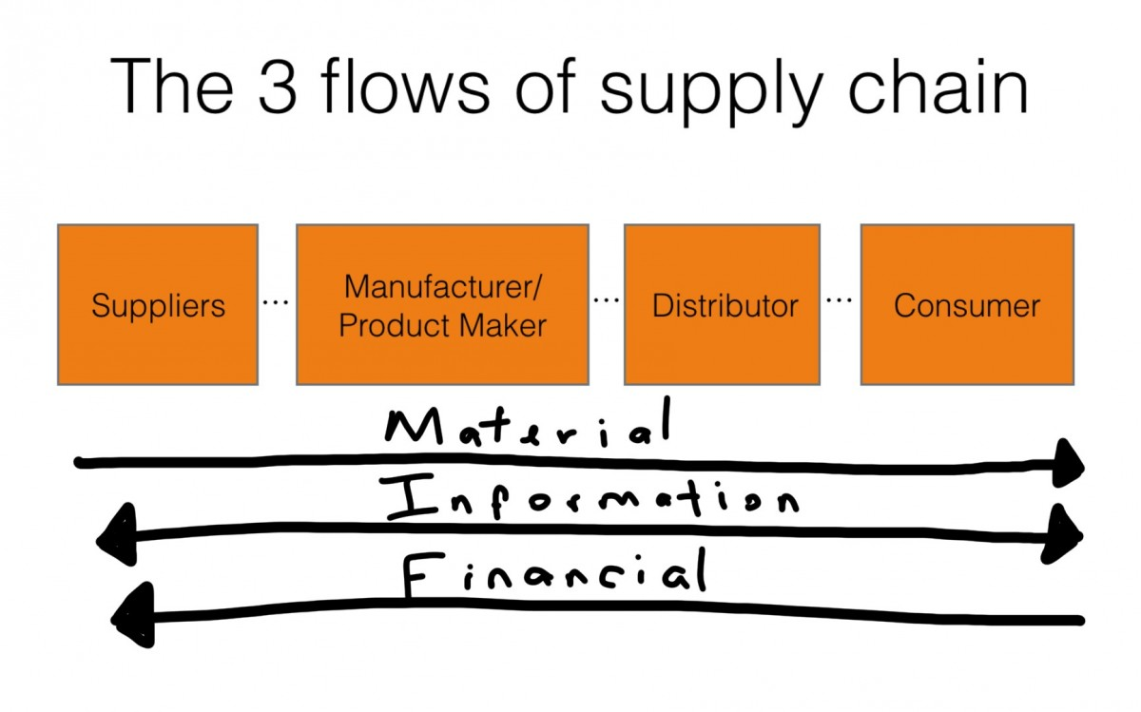
Value Chain Activities and Organizations

Slide 5
Organizational data management
Organizations, like people, need to remember many things
Deciding where and how to store data frequently involves a trade-off
Organizational data are used and generated by a variety of information systems

Slide 6
Components of Organizational Memory
People/Conversations
Tables/Documents
Video/Images/Graphics/Multimedia
Models
Knowledge/Decisions
Specialized memories

Slide 7

Org. Memory and Data Mgmt.
Notes:
An important feature of all of them: atomic transactions

Slide 8
Desirable Attributes of Data
Access convenience: easy to use
Cost-efficiency
Scalability: easy and flexible to expand
Portability: sharing, transportability, duplication
Security: safety, protection, etc.
Reliability: permanent storage
Informational quality: accuracy, timeliness, relevance, completeness, etc.
Operational flexibility: addition, modification, deletion,…
Sophistication and complexity in usage: different search approaches
Data consistency in
Data manipulation: addition, modification, deletion
Distributed environment
Transaction atomicity
Multi-user

Slide 9
Which Approach?
 | Index Cards | Notebook | Filing Cabinet | Human Brain
Access convenience
Cost-efficiency
Scalability
Portability, sharing
Security and safety
Reliability and persistence
Informational quality
Operational flexibility
Sophistication in usage
Consistency

Slide 10
Domain | Usage of Database | Companies | Databases
Social Media Platforms | User Management and Social Graphs; Content Management; Recommendation Systems | Facebook, Instagram, Twitter | MySQL, Cassandra, HBase
Financial Services | Account Management and Transaction Processing; Trading Systems; Financial Reporting and Regulatory Compliance | JPMorgan Chase, Fidelity | Oracle, IBM DB2, MS SQL Server
eCommerce Websites | Product Catalog and Inventory Management; Customer Profiles and Personalization; Order Processing and Fulfillment | Amazon, WooCommerce | MySQL, DynamoDB
Healthcare Systems | Electronic Medical Records (EMR) stores patient demographics, medical history, diagnostic test results, medications, and treatment plans; Complying with data protection regulations such as HIPAA | Mayo Clinic, Healthcare.gov | NoSQL databases, PostgreSQL
Ride-Hailing Applications | Store data in several types and formats, including driver profiles, user accounts, trip information, and payment transactions. | Uber, Lyft | Cassandra, MySQL, PostgreSQL
Email Services | Manage user data related to email transactions and accounts, store and organize messages, attachments, contact lists, folder structures, and user preferences | Gmail | Google Bigtable

Slide 11
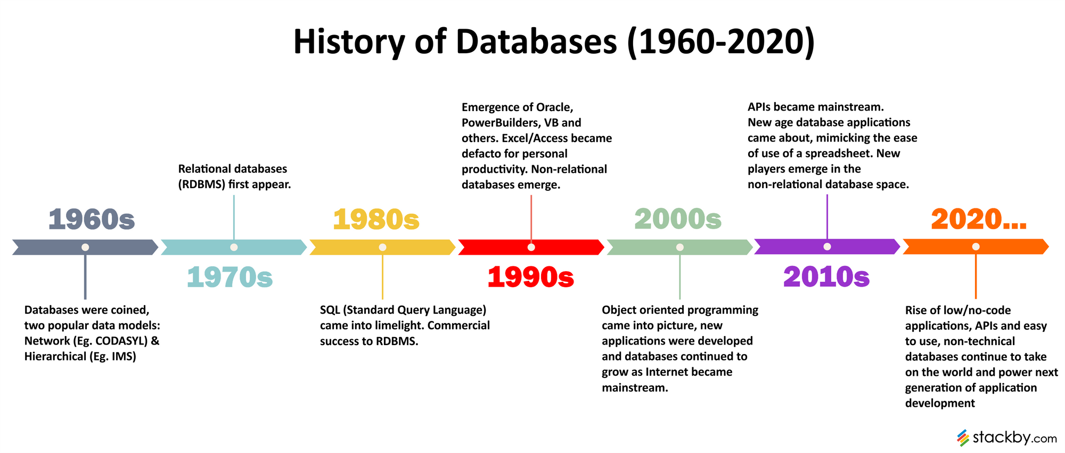
Data management systems timeline

Slide 12
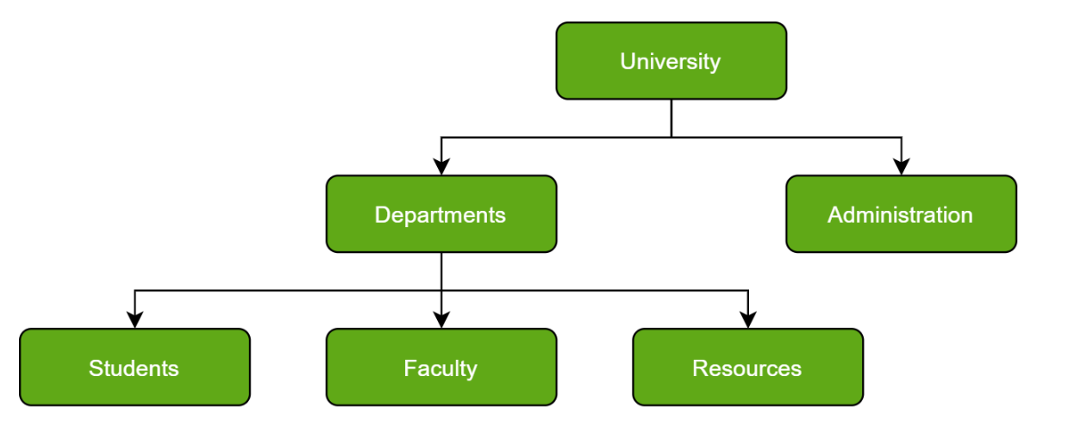
Hierarchical Databases
Data are categorized in ranks or levels.
Notes:
https://www.geeksforgeeks.org/types-of-databases/
The difference between relational and hierarchical databases lies in the data structures. While the hierarchical database architecture is tree-like, data in a relational database is stored in tables with a unique identifier for each record. A relational database structure facilitates easy identification and access of data in relation to other data points in the database. The tables are separate from physical storage structures, which enables database administrators to alter physical data storage without reorganizing the database tables themselves.
Characteristics of hierarchical database models include their simplicity, but also their lack of flexibility. Hierarchical structures, unlike, relational databases, do not describe many-to-one relationships or many-to-many relationships due to the fact that child records can only have a single parent.

Slide 13
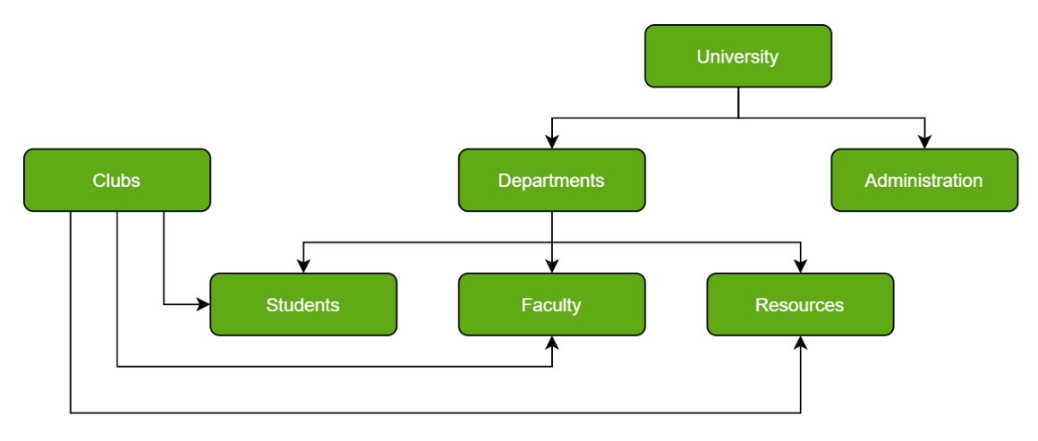
Network Databases
Network of database files linked with multiple threads
Notes:
From the book Designing Data-Intensive Applications by Martin Kleppmann.
In the network model, the database had a schema that specified which record type could be nested within which other record type. In a graph database, there is no such restriction: any vertex can have an edge to any other vertex. This gives much greater flexibility for applications to adapt to changing requirements.
In the network model, the only way to reach a particular record was to traverse one of the access paths to it. In a graph database, you can refer directly to any vertex by its unique ID, or you can use an index to find vertices with a particular value.
In the network model, the children of a record were an ordered set, so the database had to maintain that ordering (which had consequences for the storage layout) and applications that inserted new records into the database had to worry about the positions of the new records in these sets. In a graph database, vertices and edges are not ordered (you can only sort the results when making a query).
In the network model, all queries were imperative, difficult to write and easily broken by changes in the schema. In a graph database, you can write your traversal in imperative code if you want to, but most graph databases also support high-level, declarative query languages such as Cypher or SPARQL.

Slide 14
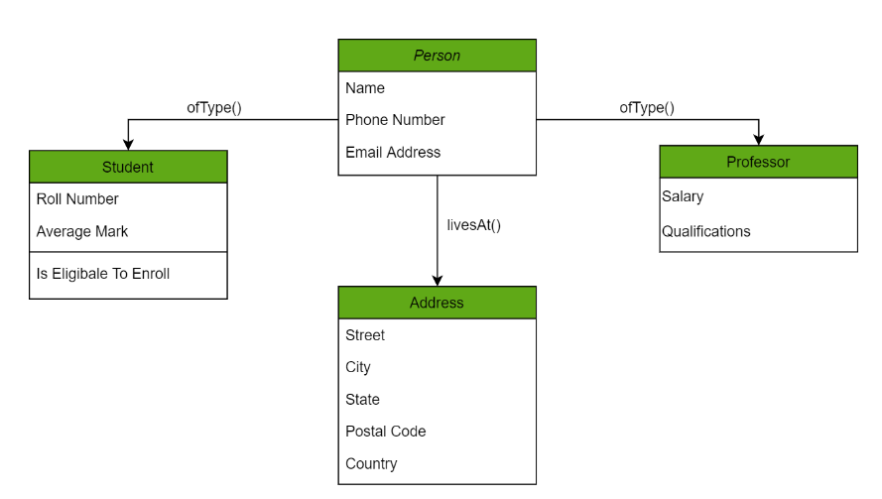
Object-Oriented Databases
Each instance represents an object

Slide 15
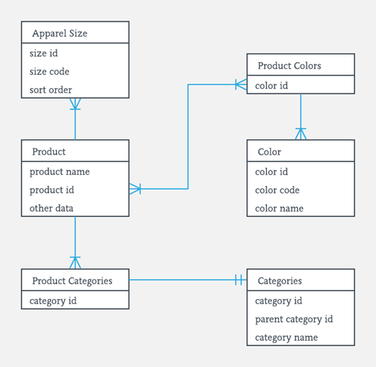
Relational Databases
Entities are related by common values.
MySQL, Oracle,
SQL Server;
PostgreSQL;
SQLite

Slide 16
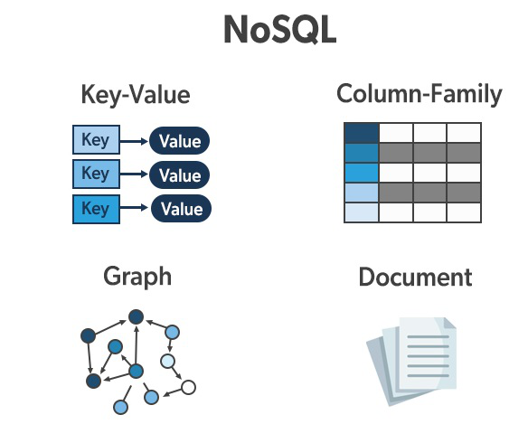
NoSQL Databases
non SQL or non-relational
MongoDB, Neo4j
Cassandra, Redis

Slide 17
Databases Supporting AI
 | Uses for AI Development and Deployment | Examples
Relational (SQL) DB | Natural language querying and prompt engineering; Hybrid search techniques; Vector storage, search, and integration; Embedding management; Advanced document retrieval; JSON Relational Duality Views; Graph Relational Unification | Microsoft Azure and SQL Server; Oracle Database 23ai Google Bigquery
NoSQL DB | Unstructured, multimodal data management and processing; High volume of data handling; Real-time recommendations and analytics; Richer representation of data and knowledge. | Netflix’s Cassandra; PayPal's and Domino’s Couchbase; Snapchat’s Amazon DynamoDB

Slide 18
Challenges with data mgmt systems
Redundancy
Lack of data control
Interface issues
Lack of integration
Lack of reality

Slide 19
Organizational Challenge
Organizations that effectively use data, information, and knowledge are more successful
The challenge is to develop data management and exploitation skills across an organization
Many organizations do not make effective use of the data they already have
Data management is an enduring problem for nearly all organizations and societies

